Slide 1

GEETHANJALI INSTITUTE OF SCIENCE AND TECHNOLOGY
DEPARTMENT OF COMPUTER SCIENCE AND TECHNOLOGY

Slide 2
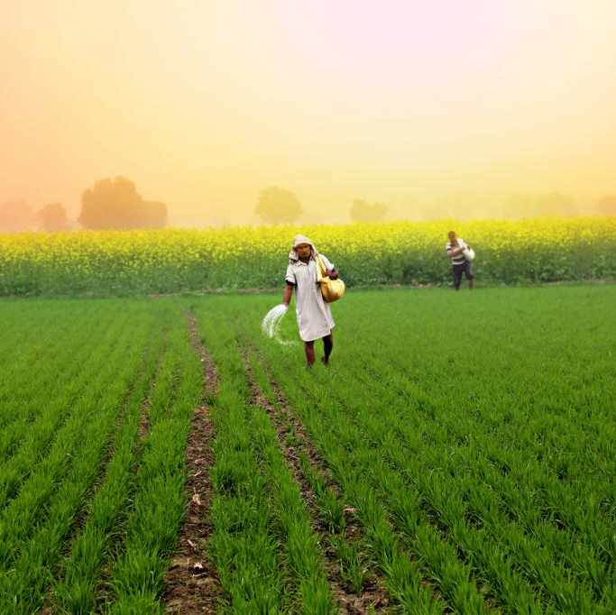
ADDRESSING THE PROBLEMS FACED BY FARMERS DURING CROP PRODUCTION
Presented by :
SK. Mansoor (212U1A0594)
S. G. B. Sanath Kumar (212U1A05A8)
K. Vishnu Vardhan (222U1A0502)
N. Tarun (212U2A0570)
Under the guidance of :
MS. CH. Vasavi
(Assistant professor , Department of CSE)

Slide 3
ABSTRACT
This community service project aims to address the difficulties faced by farmers in successfully growing crops. Farming is a vital profession that feeds our communities, but it comes with various challenges that impact crop growth. This project seeks to understand these difficulties and provide support to farmers and enhance agriculture productivity
Through this initiative, we conducted surveys and field visits in “Chiruvella Khandrika”. Based on that field visits, the challenges may include Labour shortage, Market Access and price fluctuations, Pests and Diseases.

Slide 4
INTRODUCTION
Agriculture is vital for our society, but farmers face numerous challenges in crop production. Environmental factors include unpredictable weather, climate change, pests, diseases, and soil degradation.
Economic challenges involve fluctuating market prices, limited credit access, high input costs.
Technological barriers include limited knowledge of advanced farming techniques.
This project aims to address these challenges and propose effective solutions.
Focus areas include promoting sustainable practices, providing knowledge about advanced technologies, enhancing market linkages.

Slide 5
Our project the following crop problems :
W -Wheat
G - Lemon
E - Eucalyptus
M - Mango
C - COTTON

Slide 6
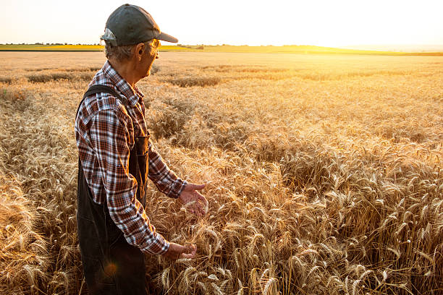
WHEAT
Unpredictable weather patterns (droughts, floods, extreme temperatures).
Soil erosion
Labour Shortage
Market price fluctuations

Slide 7
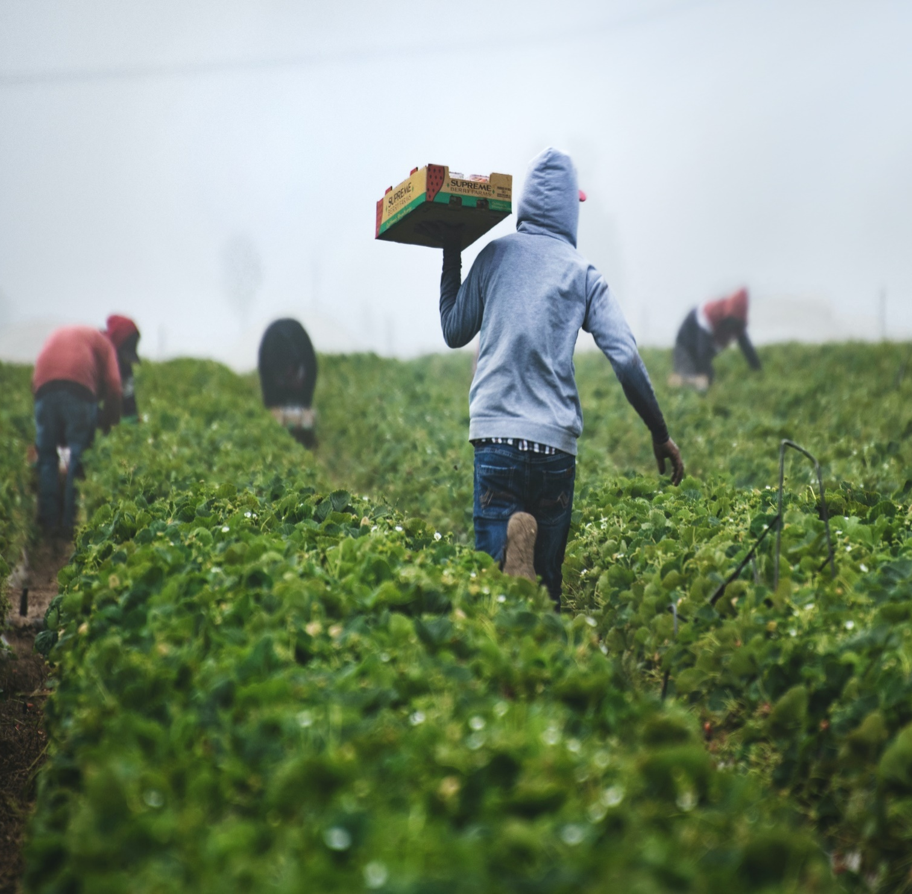
COTTON
High cost of fertilizers
Pest and disease infestation
Labour wages
Less MSP
Low rate return

Slide 8
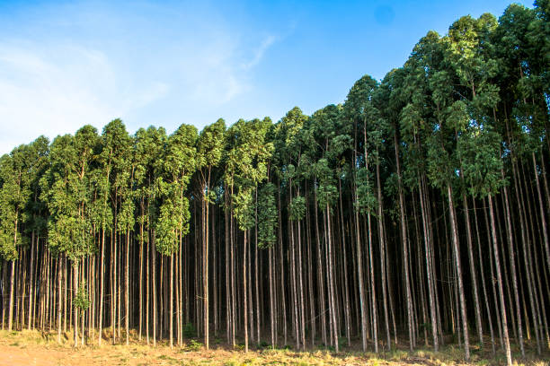
EUCALYPTUS
Water management
Market demand and pricing
Climate and weather
Soil requirement

Slide 9
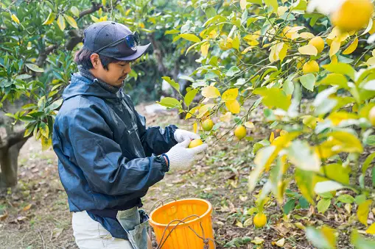
LEMON
Climate conditions
Pests and diseases
Market price fluctuations
Water availability

Slide 10
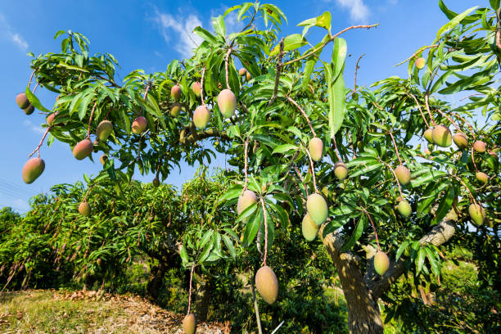
MANGO
Climate and weather conditions
Water management
Harvest and post harvest management
Market demand and pricing

Slide 11
Solutions to Overcome Challenges in Crop Production
Unpredictable weather patterns:
Stay updated with weather forecasts and utilize early warning systems to prepare for extreme weather events.
Implement climate-smart farming practices such as crop diversification, conservation tillage, and water management techniques.
Soil erosion:
Encourage the use of organic farming practices and bio-pesticides as alternative for synthetic pesticides.
Implementing good land management practices, such as avoiding overgrazing, and promoting crop rotation

Slide 12
High cost of fertilizers:
Conduct regular soil tests to determine the specific nutrient needs of your fields. This will help you apply fertilizers more efficiently, avoiding over-application and unnecessary costs.
Encourage the use of organic farming practices and bio-pesticides as alternative for synthetic pesticides.
Conducting soil testing to access the nutrient levels. Based on that result apply balanced fertilizers.
Market price fluctuations:
Instead of paying workers a fixed daily or hourly wage, they are compensated based on the quantity of cotton they harvest or the number of tasks they complete.
Improving the market information systems, Including mobile apps which can provide the farmers up-to-date price information based on that information farmers can cultivate the crops based on the demand.

Slide 13
Pest and Disease Infestation:
Rotating crops to disrupt weed cycles and to reduce weed pressure. Utilize precision farming technologies such as GPS-guided equipment, drones and sensors
Implementing an integrated weed management approach, including cultural mechanical and chemical methods.
Labour Wages:
Instead of paying workers a fixed daily or hourly wage, they are compensated based on the quantity of cotton they harvest or the number of tasks they complete.
Labour Shortage:
Farmers can adopt the mechanisms and automated mechanism techniques to reduce labour work.
Training programs should be implemented to enhance the skills of the farm labour.

Slide 14
Water management:
Consider using drip irrigation systems for precise water application. Drip systems deliver water directly to the root zone, minimizing water loss and reducing weed growth.
Invest in irrigation infrastructure, such as small-scale irrigation systems and water storage facilities. Promote water-efficient irrigation methods like drip irrigation. Provide training on water management techniques to optimize the water.
Harvest and post harvest management:
Educate farmers on proper post-harvesting handling, including drying, cleaning, and storage techniques. Promote the use of improved storage structures like hermetic bags. Train farmers on post-harvest processing techniques, such as oil extraction and roasting.

Slide 15
FEEDBACK WHICH WE ARE GETTING DURING PROJECT

Slide 16
Types of Questions we are asked to the Farmers
Which crop do you currently cultivate?
How long have you been involved in crop production?
How has climate change affected your crop production in recent years?
Have you observed any changes in rainfall patterns or extreme weather events? If yes, please describe.
What strategies have you adopted to mitigate the impacts of climate change on your crops?
What are the specific challenges you face due to climate variability?
Do you face any challenges in accessing resources and technology for crop production? If yes, please elaborate.
How do market price fluctuations affect your crop sales and profitability?
Have you received any assistance or support from agricultural extension services, government programs, or NGOs? If yes, please provide details.
How does soil degradation impact your crop production?
Do you face any challenges in maintaining soil health and fertility?
How does soil degradation impact your crop production?

Slide 17
CONCLUSION:
In conclusion, farmers face various challenges during crop production that can significantly impact their livelihoods and the overall agricultural sector. The problems encountered by farmers range from unpredictable weather patterns, pest infestations, and diseases to market price fluctuations, high input costs, and limited access to resources and knowledge.
By acknowledging the problems faced by farmers and actively working towards solutions, we can create a more favorable environment for agricultural development, support farmer livelihoods, and contribute to a resilient and sustainable food system for the future.

Slide 18


